Slide 1
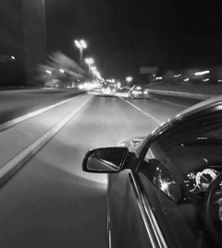
CAR ACCIDENT DETECTOR & INFORMER
Changes call for innovation, and
innovation leads to progress.
-Li Keqiang
TEAM > CODE RIDERS :
SHUBHAM KUMAR SINGH
JAHANVI SHARMA
VAIBHAV SINGH

Slide 2

PROBLEMS :
1. No notification system in car to notify about accident
2. Car tracking not available
3. No Emergency system to notify about injured
4.No system to notify damage percentage of car
5.No system to find lost and stolen cars.

Slide 3

PURPOSE & GOAL
This device is for the automation of accident detection and notifying the hospitals, police stations and relatives about the accident data.
The proposed device is for accident notification system (A.N.S). This product will be used in vehicles to get the data of accident and further notifying police station and hospitals.
Goal: It will reduce the no of deaths in accident cases and will help to track data of car .Including, will help to solve various cases of road accident and will able to find the culprit.

Slide 4
Current systems :
At present criteria, we cannot detect where the accident has occurred and hence no information related to it, leading to the death of an individual.
Some of the systems can detect accidents and send location to hospitals / ambulance thorough your phone location only .
Most of the accident detection systems rely on the high speed of the vehicle extracted from the smart phone GPS receiver .
In some system only the buzzer will raise during any accidents, and hence the patrol cannot exactly locate the accident spot.

Slide 5
Our IDEA :
GPS tracking system to be enabled in car.
Instant notification system to be enabled to notify hospital in alarming case.
Sound notification in hospital and message notification with location.
In case of lost car GPS will track car and detect the location.
Recorded data of car movement will be maintained.
GPS system to be attached with car no. and owner details.
After accident sound alarm will be played and then will be cached by sound sensor which further will send notification.
Notification will be sent with car number and owner details.
After searching for car details will get actual location of cars and can contact owner.

Slide 6

SOLUTION :
Instant Notification to Hospital in case of accident.
Instant medical support to the injured person.
Instant information to the driver family.
Sound alarm information to locals present in the area.
Information regarding the car movement and history of car movement.
Information regarding the vehicle movement can help in solving many mysteries of various crimes.
Instant notification to police station and hence easy finding the reason of accident.

Slide 7
SYSTEM FEATURES
•Description and priority:
The accident notification System notifies or informs about the accident spot , time to the nearby hospital , police station and family members .Of course, this project has very high priority in order because will save life in road accident .
•Stimulus/Response Sequences
Accident will be detected by accelerometer.
Engine stops.
Alarm starts.
Gsm model activates and send notification.

Slide 8
SYSTEM FEATURES
EXTERNAL INTERFACE REQUIREMENT
User Interface :
Car Driver with car
Hardware interface :
Power supply with processor
ARDUINO UNO
Accelerometer with processor
GSM with Processor as input and output.
GPS with processor as input and output and device tracker .
Display unit for output from processor.

Slide 9
SYSTEM FEATURES
Software Interface :
Attaching and integrating message system with Display .
Calling Api of google map and converting longitude and longitude to location.
Communications Interfaces
The device uses latest messaging apps ex. messenger
Location sent can be used by any browser.

Slide 10
USER INTERFACE
System can track geographical information automatically and sends an alert SMS regarding accident.
Arduino system sends the alert message through the GSM MODULE to police , hospital , relatives. So the they can immediately trace the location through the GPS MODEM, after receiving the information. Then after conforming the location necessary action will be taken.
If the person meets with a small accident or if there is no serious threat to anyone`s life, then the alert message will be terminated.
If there is any damage to the device then the second part attached with airbag inflator starts working which when gets excess of nitrogen pumps and on the sensor which further send the notification.

Slide 11
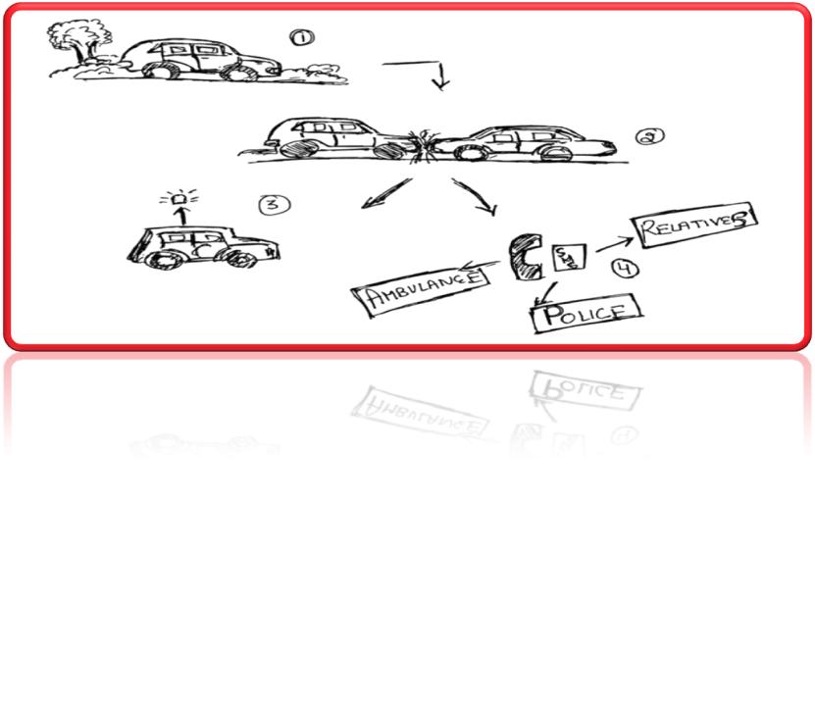
ROUGH SKETCH
At first point car is moving
And then suddenly an accident take place at alone place or anywhere .
It will also help in notifying clear by person by its sound system.
Then our accidential and informer system will notify to person’s family / relatives , to police & to ambulance or nearby hospital

Slide 12
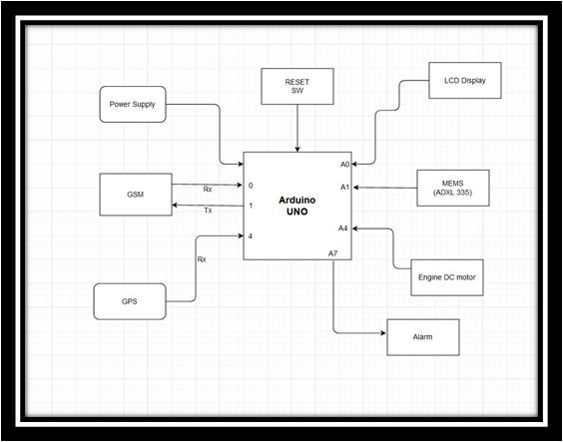
BASIC DIAGRAM OF OUR CIRCUIT WITH MODULES

Slide 13


CODE FOR ACCIDENT LOCATION DETECTOR AND FOR SENDING MESSAGES
void initModule(String cmd, char *res, int t)
{
while(1)
{
Serial.println(cmd);
Serial1.println(cmd);
delay(100);
while(Serial1.available()>0)
{
if(Serial1.find(res))
{
Serial.println(res);
delay(t);
return;
}
else
{
Serial.println("Error");
}
}
delay(t);
}
}

Slide 14

CODE FOR ACCIDENT LOCATION DETECTOR AND FOR SENDING MESSAGES
void setup()
{
Serial1.begin(9600);
Serial.begin(9600);
lcd.begin(16,2);
lcd.print("Accident Alert ");
lcd.setCursor(0,1);
lcd.print(" System ");
delay(2000);
lcd.clear();
lcd.print("Callibrating ");
lcd.setCursor(0,1);
lcd.print("Acceleromiter");
for(int i=0;i<samples;i++)
{
xsample+=analogRead(x);
ysample+=analogRead(y);
zsample+=analogRead(z);
}
xsample/=samples;
ysample/=samples;
zsample/=samples;
Serial.println(xsample);
Serial.println(ysample);
Serial.println(zsample);

Slide 15

CODE FOR ACCIDENT LOCATION DETECTOR AND FOR SENDING MESSAGES
void loop()
{
int value1=analogRead(x);
int value2=analogRead(y);
int value3=analogRead(z);
int xValue=xsample-value1;
int yValue=ysample-value2;
int zValue=zsample-value3;
Serial.print("x=");
Serial.println(xValue);
Serial.print("y=");
Serial.println(yValue);
Serial.print("z=");
Serial.println(zValue);
if(xValue < minVal || xValue > MaxVal || yValue < minVal || yValue > MaxVal || zValue < minVal || zValue > MaxVal) {

Slide 16

CODE FOR ACCIDENT LOCATION DETECTOR AND FOR SENDING MESSAGES
void serialEvent() { while (Serial.available()) //Serial incomming data from GPS { char inChar = (char)Serial.read(); str[i]= inChar; //store incomming data from GPS to temparary string str[] i++; if (i < 7) { if(str[i-1] != test[i-1]) //check for right string { i=0; } } if(i >=60) { break; } } }

Slide 17

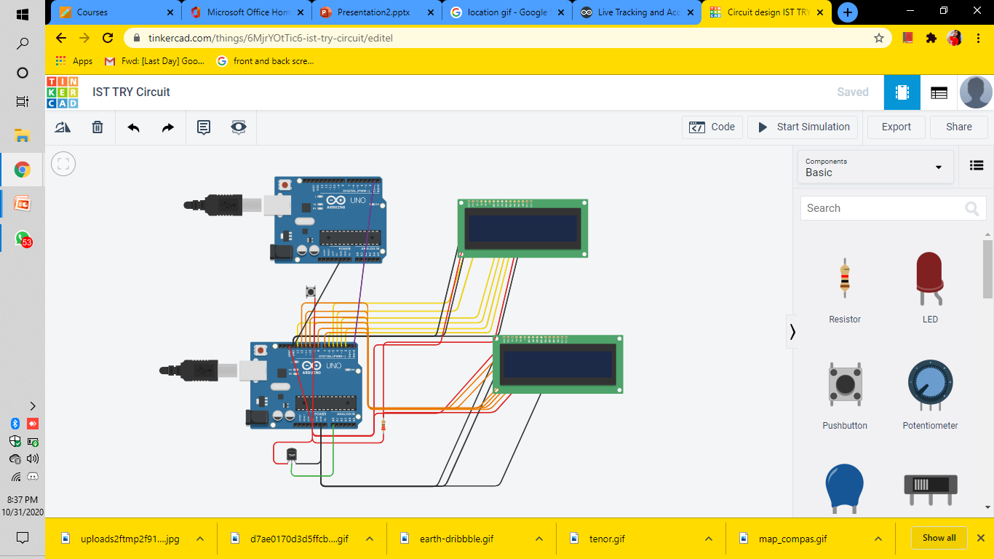
OUTPUT : GLOBAL POSITIONING SYSTEM (GPS) CIRCUIT

Slide 18
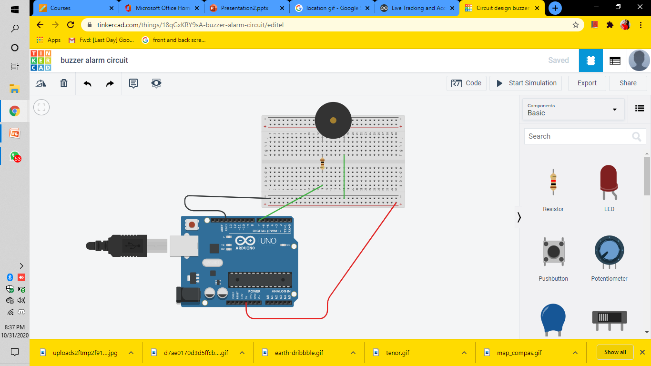
OUTPUT : BUZZER ALARM DETECTION

Slide 19
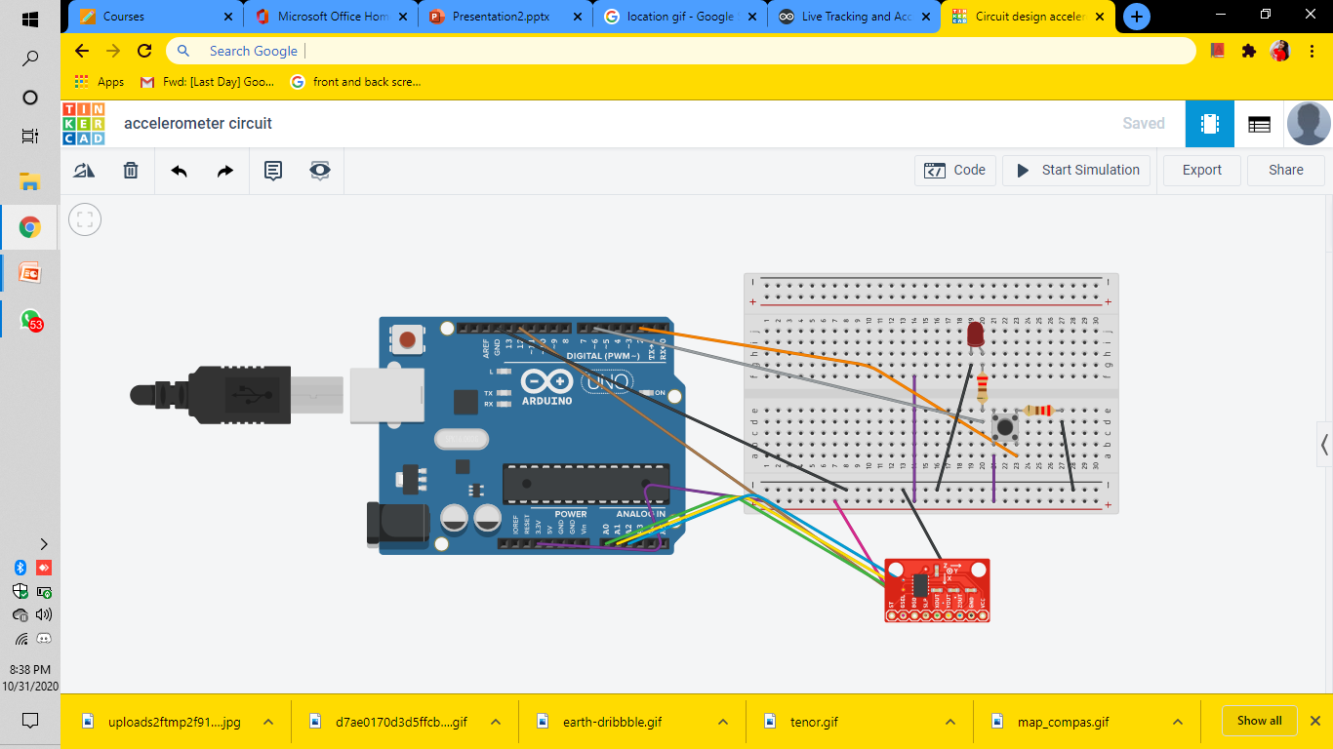
OUTPUT : ACCELERO - METER USING ADXL-335

Slide 20

THANK YOU
ANY QUESTIONS :

